Slide 1
Integrating with APIs
Working with REST, JSON, and OData

Slide 2

Caitlin Bales
Community Engineer @ Microsoft
Working on tooling for APIs
Web enthusiast
Worked on API strategies from creation to consumption

Slide 3
Steps to Integration
Why APIs?
REST
JSON
cURL
Guzzle
OData
Authentication
Tools

Slide 4
API Industry
Businesses are realizing an API strategy brings them more:
Developer integration
Platform stickiness
Development speed
Some shops are becoming API-first
Reduces friction in cross-collaboration across teams
Increases dogfooding
Avoids technical debt
Great friends with open source development

Slide 5
Why use APIs?
Don’t reinvent the wheel
Spend time building business-differentiated software
Increase your data scope
Faster and cheaper than purchasing off-the-shelf solutions

Slide 6
RESTful Web Services
Stands for Representational State Transfer
Message based
A pattern for developing web services
Centered around resources
Provide a common transactional model for data transfer
Lightweight alternative to SOAP and WSDL

Slide 7
Request Recipe
VERB
+
HEADERS
+
URL
+
BODY
GET
POST
PUT PATCH DELETE
…
Accept
Authorization
Content-Length
Content-Type
Host
X-Requested-With
DNT
{
“fname”: “Bob”,
“lname”: “Barker”
}
https://api.site.com/v1/
http://bobsapi.com/user

Slide 8
JSON Data
Human-readable JavaScript Object Notation
Centers around key-value pairs
Looked to provide more readable format than XML
Most popular formatting for REST call data

Slide 9
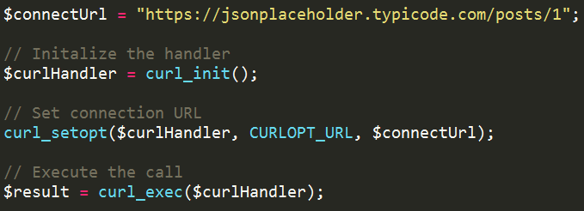
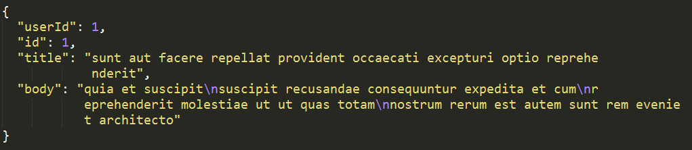
cURL - GET

Slide 10
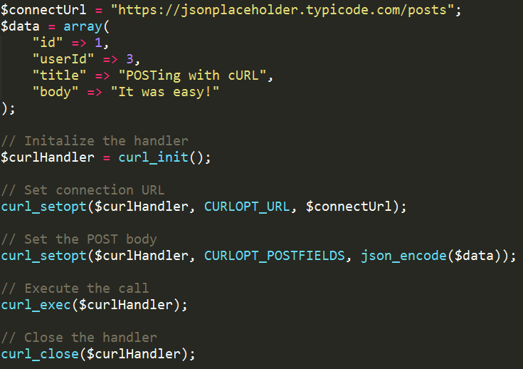
cURL - POST

Slide 11
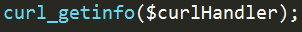
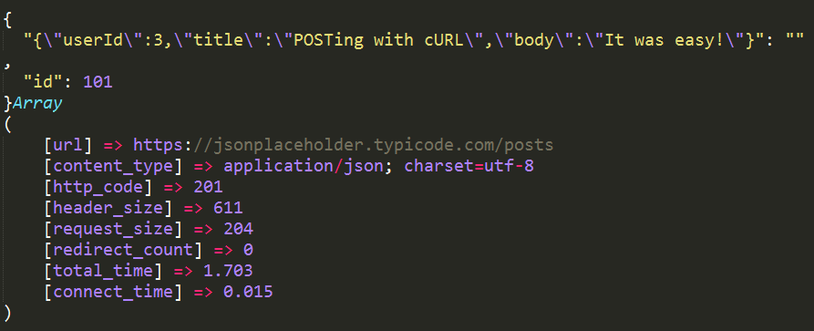
cURL - POST

Slide 12
Guzzle
PHP HTTP client
Handles boilerplate request/response code
Object-oriented
Support for asynchronous calling
Option to use other handlers (i.e. React)
Mock handlers make it easy to test

Slide 13
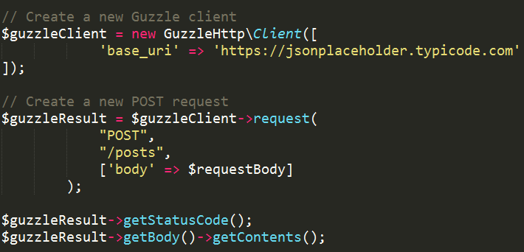
Guzzle

Slide 14
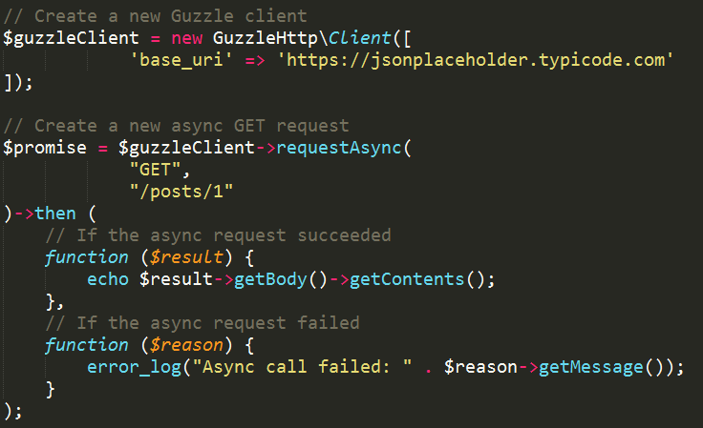
Guzzle - Async

Slide 15
OData
Supports querying
$filter, $select
Works with JSON and Atom
Navigation properties
Deltas
Annotations
$metadata – XML representation of the objects, navigation paths, and properties available

Slide 16
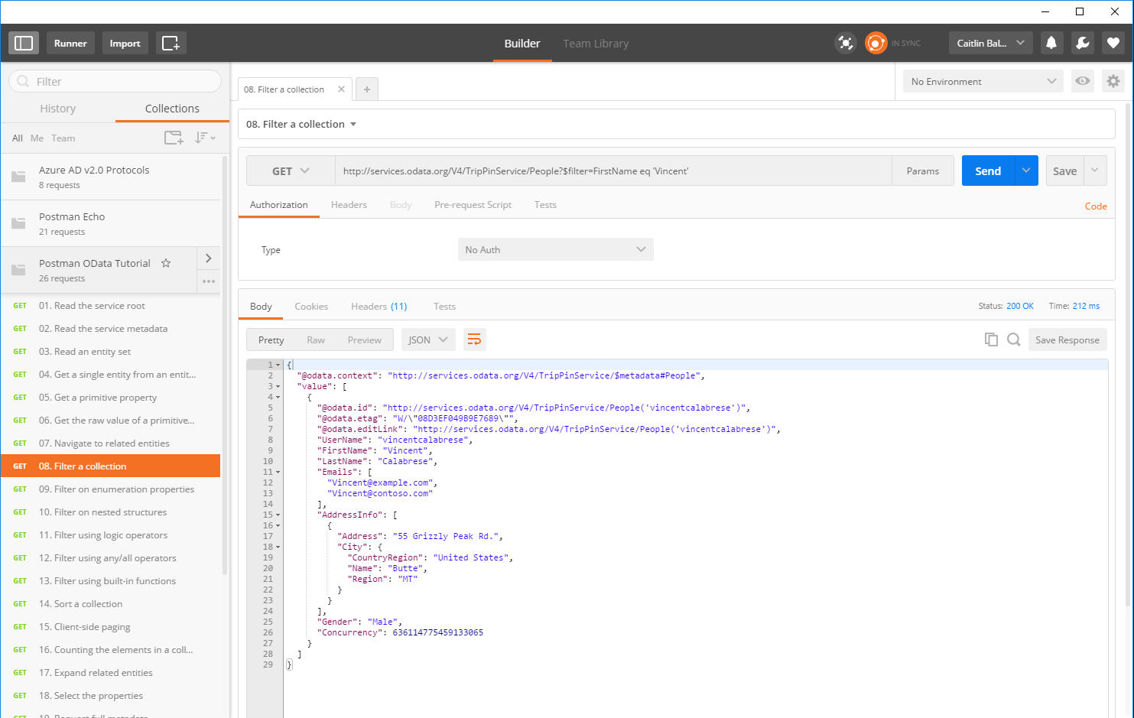

Slide 17
Authorization & Authentication
Proves to the service that you are allowed to access its resources
Allows you to access public information
Usually involves a public/private key pair
Proves that you are who you say you are
Allows you to access personal information
After authenticating, you receive a token which is then used to authorize you

Slide 18

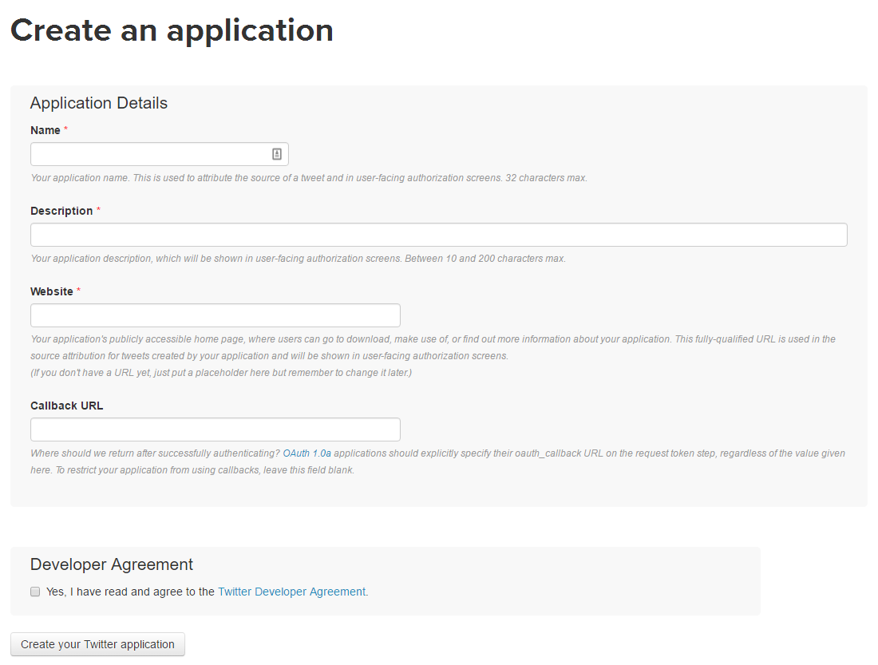
Setting up Authentication with an API
Most companies have you register an application with them on their site
You’ll get a public/private key pair
Request and callback URLs ensure app security

Slide 19
OAuth2
The user is prompted to login to API service and authorize the app to use their data
The server sends back an authorization code to the app
The app uses this code to ask for an access token
The server returns an access token to the client
Subsequent calls to the service use this access tokens
It’s secure because these tokens expire
Using a refresh token, you can get a new valid access token
Notes:
Most services use OAuth or OAuth2 to authorize and authenticate applications

Slide 20

Postman
Started as a simple Chrome plugin for making HTTP requests
Allows you to test queries quickly without a shell application
Lots of other goodies
Collections
Test cases
Documentation
Sharing

Slide 21
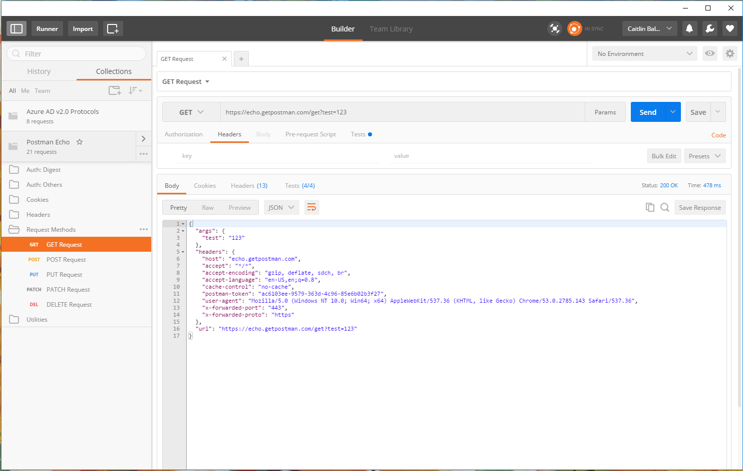

Slide 22

Fiddler
HTTP debugging proxy server
Captures data sent across the wire – Internet, Intranet, and native apps
Allows editing of requests for testing purposes
Mac & Linux builds in Alpha
Intercept requests
Send requests

Slide 23
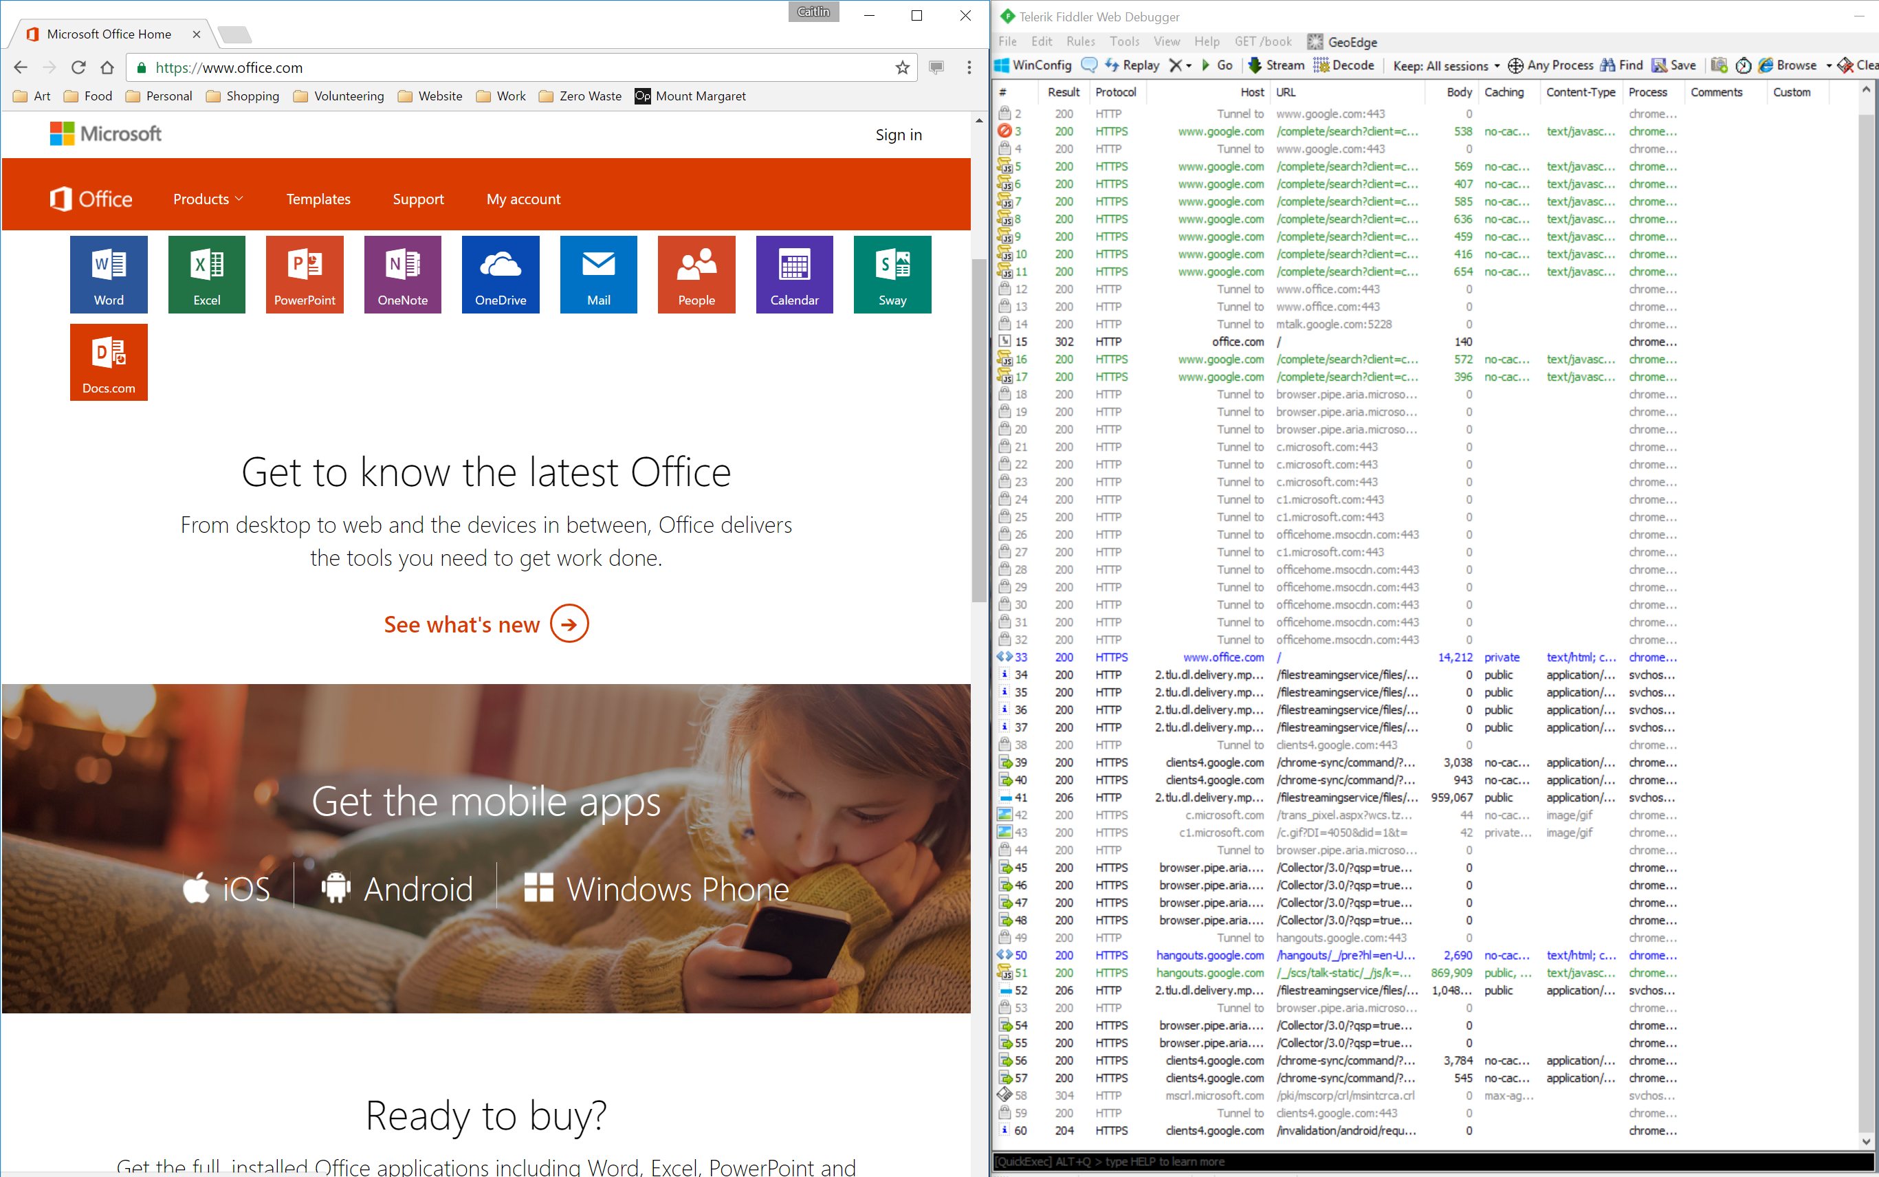

Slide 24
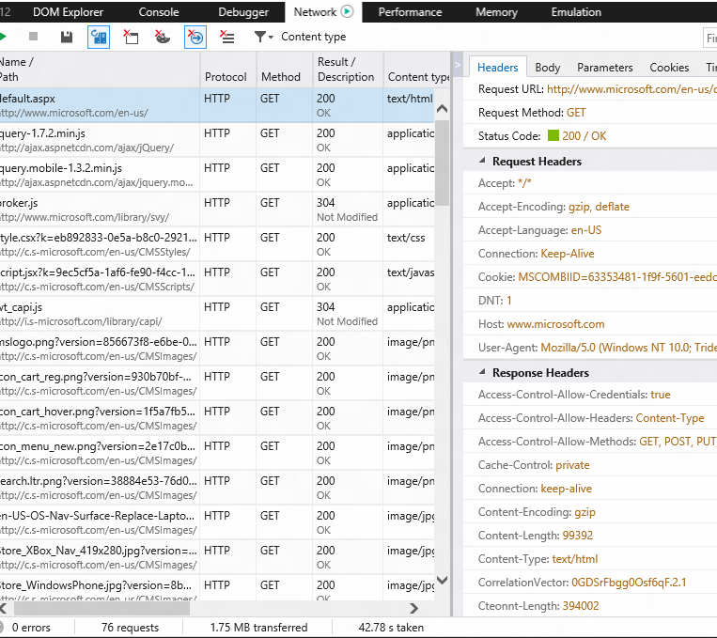
Modern Browser Tools
View requests and responses of web apps
Support remote sessions
Good for sniffing web traffic
There’s even APIs for debugging APIs!

Slide 25
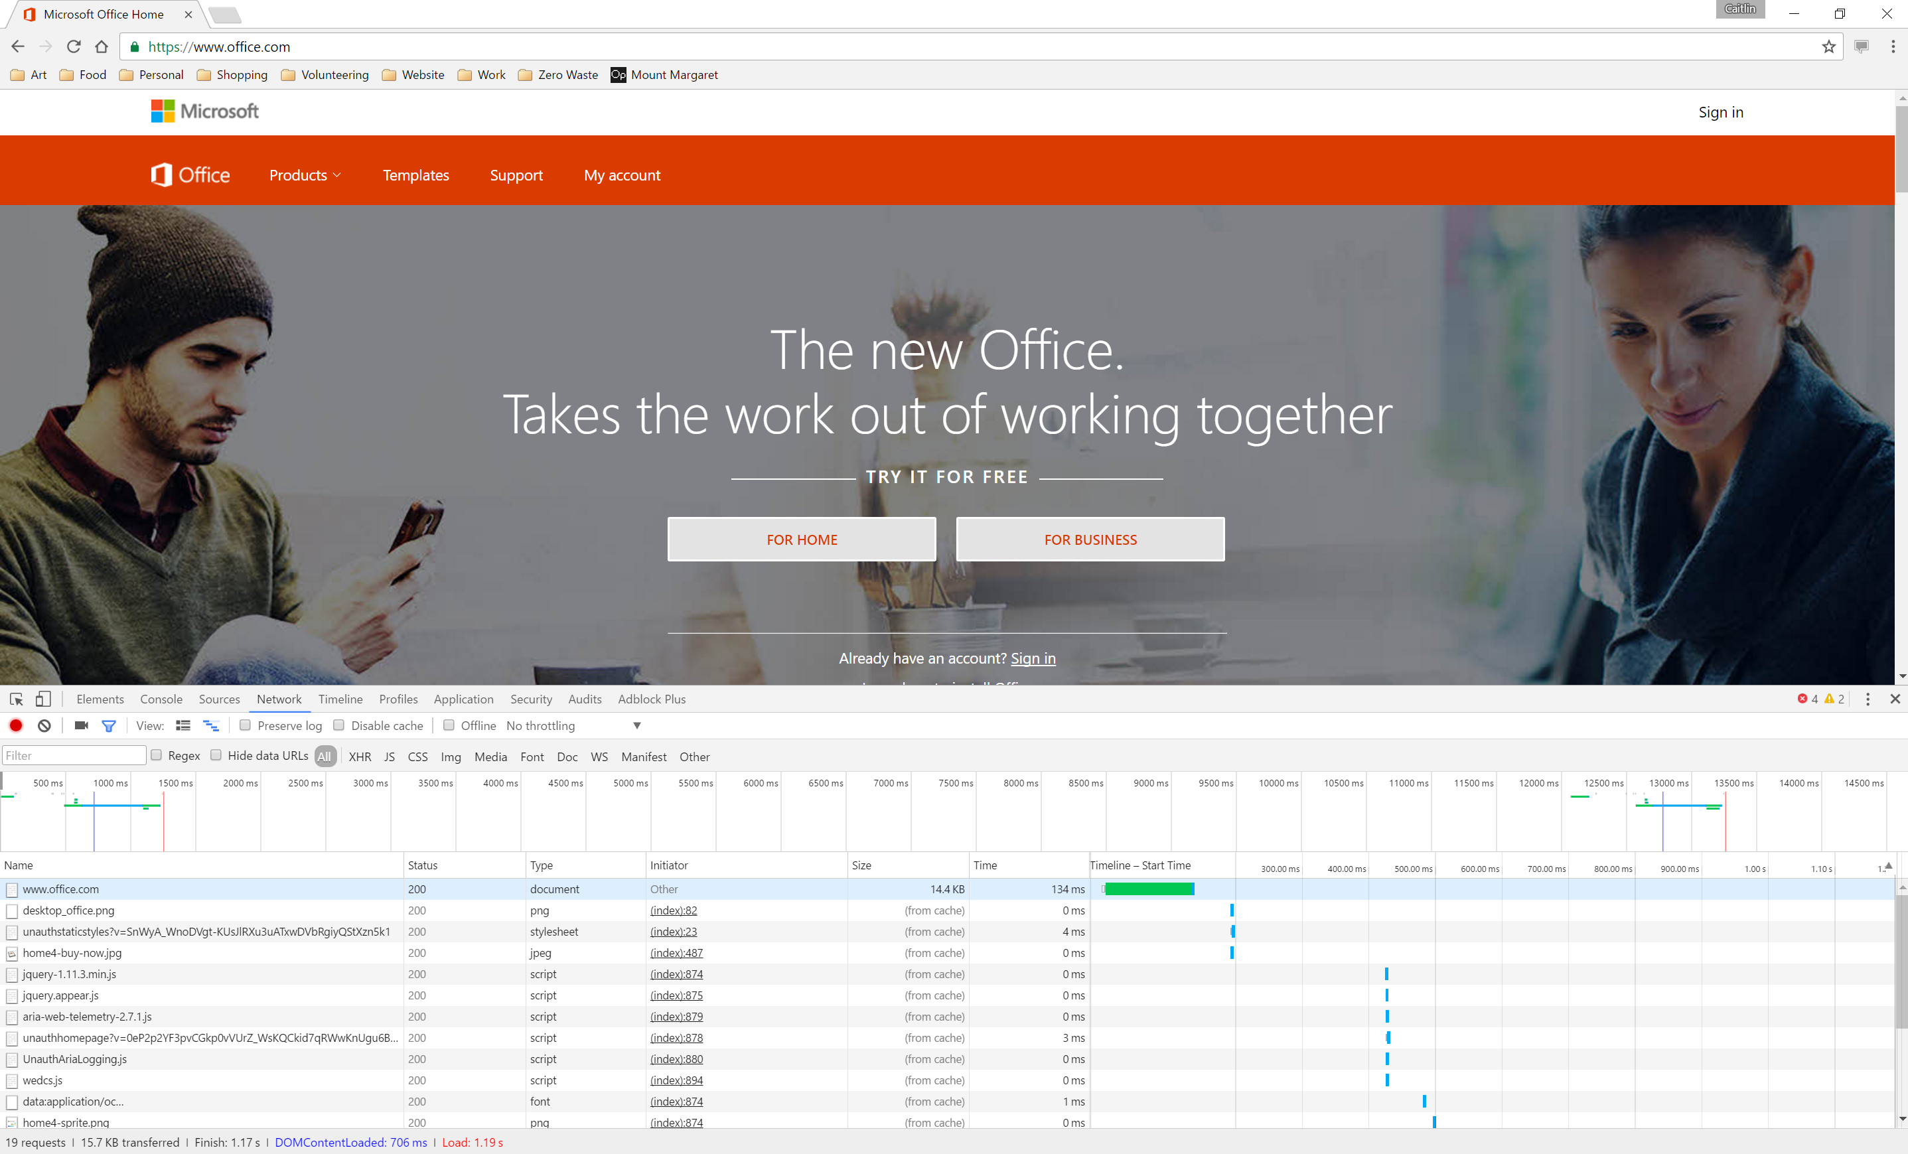

Slide 26
Resources
Slides & sample code – github.com/cbales
Programmable Web
Nordic APIs REST vs SOAP
Build a lightweight API with Slim

